Slide 1

Medical Insurance Charges Prediction
MACHINE LEARNING
PRESENTED BY DYLAN LOH

Slide 2
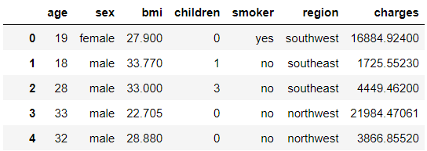
Dataset Introduction
Dataset is about the Individual Medical Costs billed by Health Insurance, in United States.
Source : https://www.kaggle.com/mirichoi0218/insurance
Size : 1338 rows with 7 columns (medium sized)
Dataset.Head()

Slide 3
Business Objective
This dataset is provided by a Insurance Company
This shows the Medical Cost that an individual could face.
We need to use Machine Learning Model to help to predict a potential customer’s Medical Risk Exposure, thereafter able to advise them on how to protect themselves against the risk.
We decide to use Linear Regression for this Model.

Slide 4
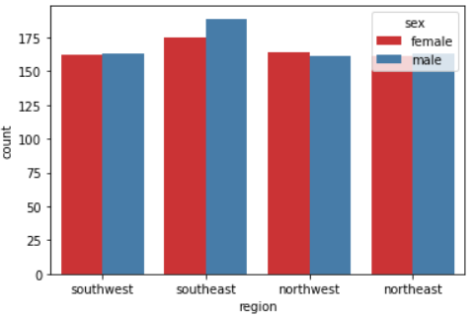
EDA - Demographic
Gender and Region
Data is evenly distributed between different gender and region

Slide 5
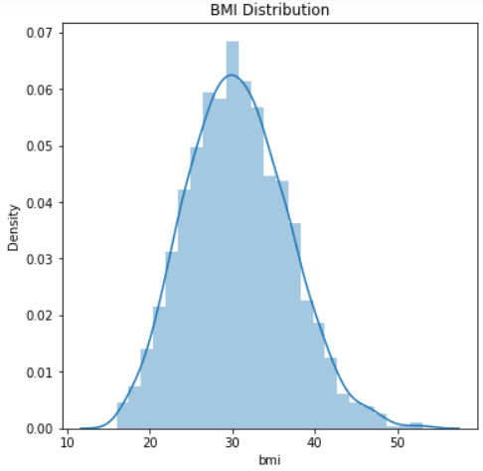
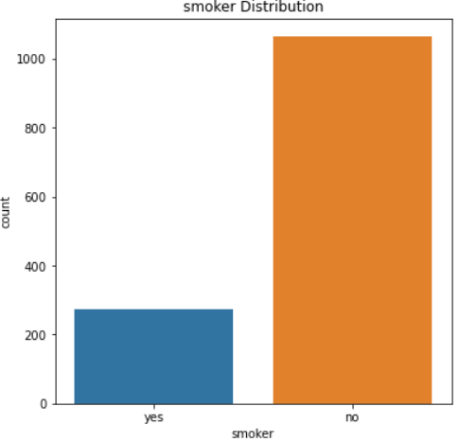
EDA - Risks
BMI Distribution
Normal BMI range falls between 18.5 – 24.9.
Mean is 30.66, which is reflects the risk of a High BMI reading.
Smoker Distribution
Surprisingly, smokers are much less in this dataset.

Slide 6
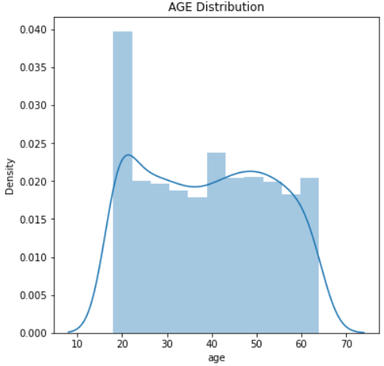
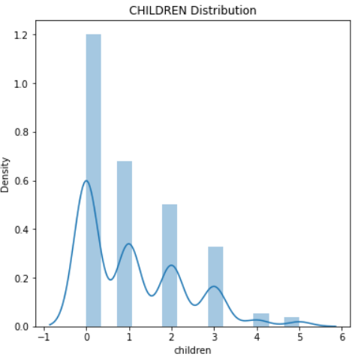
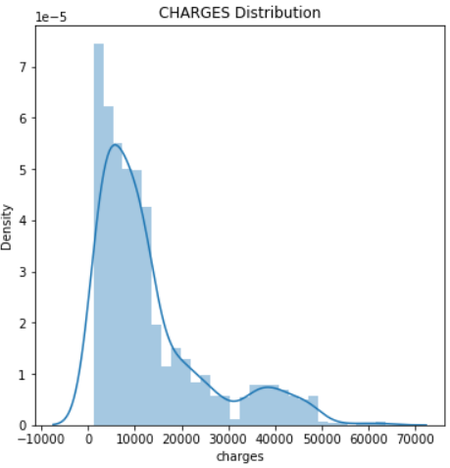
EDA – Other Distributions
Age Distributions
Most of the Claims are in their 20s.
Children Distribution
Most of the claims are young individuals
Charges Distribution
Range from USD 1,121 – USD 63,770.

Slide 7
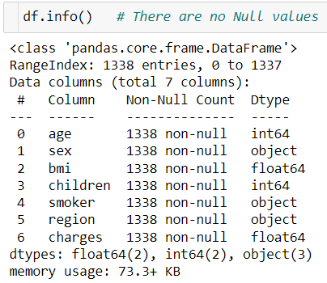
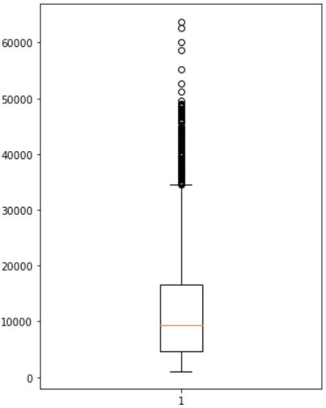
Data - Cleaning
There are no Null values
Outliers
From the boxplot of ‘charges’ column, we can see there are outliers > value ‘50,000’.
There are a total of 7 rows, hence we remove them, leaving total of 1331 rows.

Slide 8
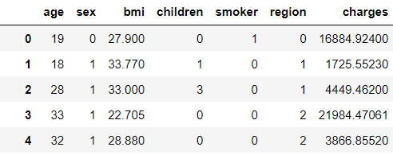
Data - Pre-processing
We convert the Categorical Features to Integer format
# sex - discrete - male / female
# smoker - discrete - yes / no
# region - discrete - southwest / southeast / northwest / northeast

Slide 9
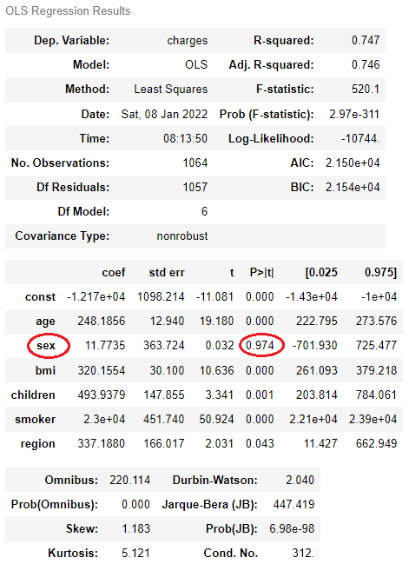
Feature Elimination - Backward Elimination
First, we split the dataset via “Train-Test-Split” so to make sure the “Test” results are untouched.
Then, we run the OLS test.
From this test, we can see the feature ‘sex’ is > 0.05, hence we decide to drop this column.
We drop this ‘sex’ column in our X.

Slide 10
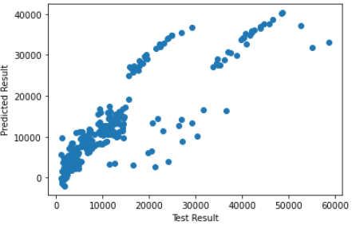
Create Linear Regression Model
Create Linear Regression Model, lr
Fit Training Data into lr
Score = 0.77
Root Mean Squared Error = 5572.97

Slide 11
Conclusion
We have created a Linear Regression Model for estimating the Medical Insurance Charges.
The model is generally good for prediction; you can see via the prediction chart are linear.
Now the company have a Model to help customer analysis their Medical Risk Exposure.

